Slide 1

PlaatSign
(Raspberry Pi Digital Content Viewer)
Open Source Project
W.B.J. van der Plaat
(Principal IT Architect)

Slide 2

Questions
How can I display digital content on a Full HD Screen remotely?

Slide 3


Idea
Lets create an (web) application were digital content can be managed
Use Linux tools to display digital content on monitor
Use low cost hardware

Slide 4
PlaatSign - Features
Web GUI to managed digital content
  JPG, GIF and PNG Images
  MP4 Video
  PHP Scripts
Display content real time on attached Full HD Monitor
Web GUI is protected with HTTPS and User Access Management

Slide 5
PlaatSign Software Architecture
Presentation Layer
HTML/CSS/JS
Apache
Business Logic Layer
PHP
Database Layer
MySQL
Digital Image
Viewer
Digital Video
Viewer
PHP Script
Engine
Linux Tools
Operating
System
Debian Linux

Slide 6

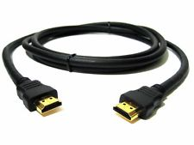
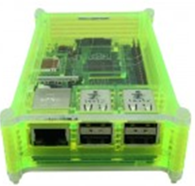
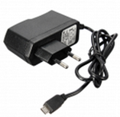

Used hardware
Raspberry Pi 3B
Raspberry Case
USB Power Supply
SD Card
Full HD Monitor
HDMI cable

Slide 7

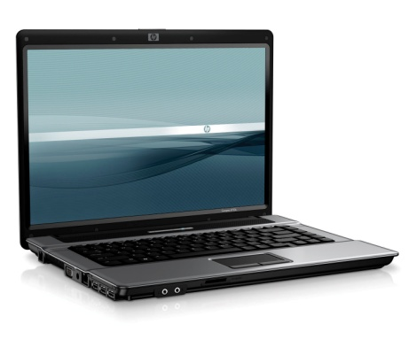
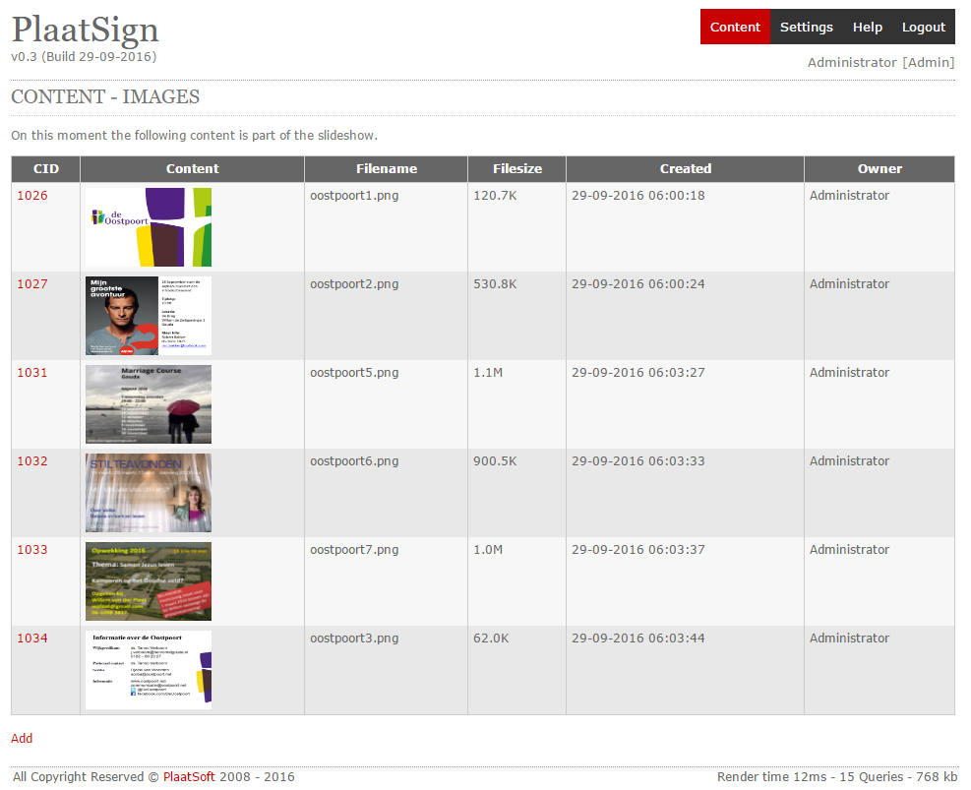
Hardware View – Configuration 1
Raspberry Pi
PlaatSign
Wifi Router
Wifi
Ethernet
ADSL Router
HDMI
Ethernet
Internet
Digital content
is displayed on
monitor
Digital content can be managed remotely

Slide 8
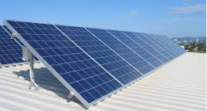
Hardware View – Configuration 2
P1 cable
Digital Energy
Meter
Bluetooth
Digital Gas
Meter
Hosola Solar
Converter
Hosola Solar
Converter
Hosola Solar
Converter
USB
Raspberry Pi
PlaatEnergy
PlaatSign
Wifi
Wifi
Wifi
Wifi Router
Wifi
Ethernet
Digital content can be managed remotely
ADSL Router
HDMI
Ethernet
Digital content
is displayed at
monitor
Internet

Slide 9
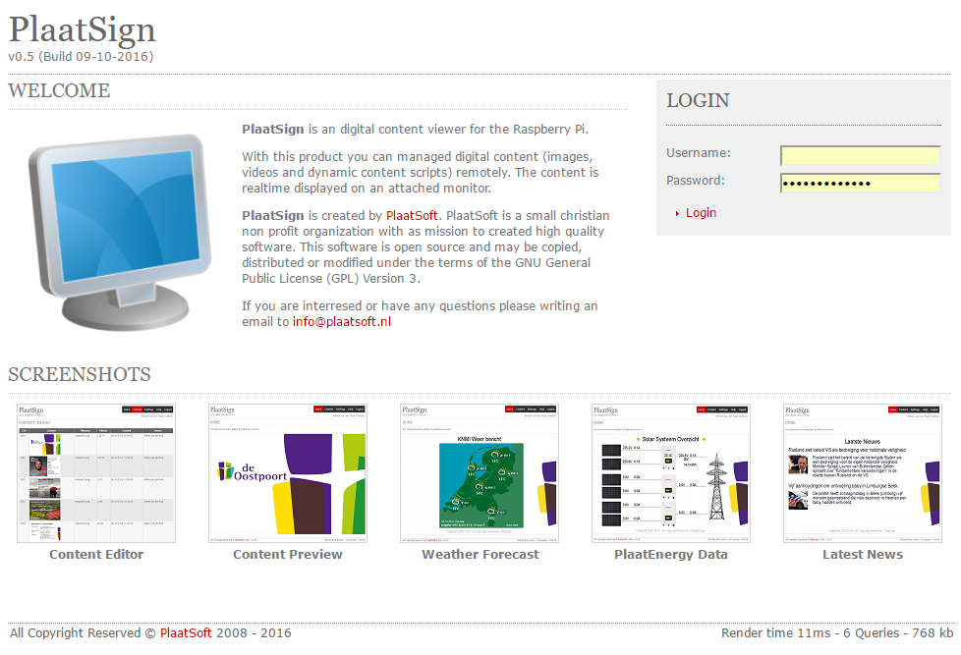
Screenshots

Slide 10
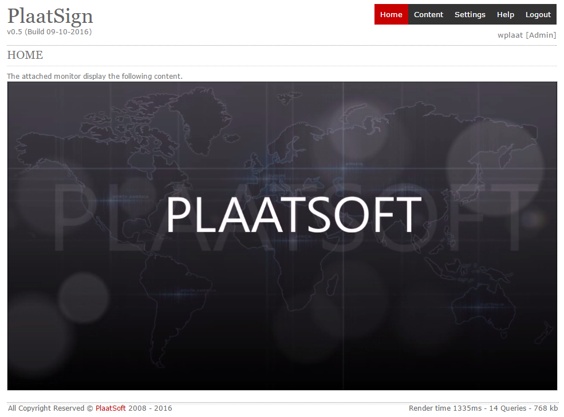

Slide 11
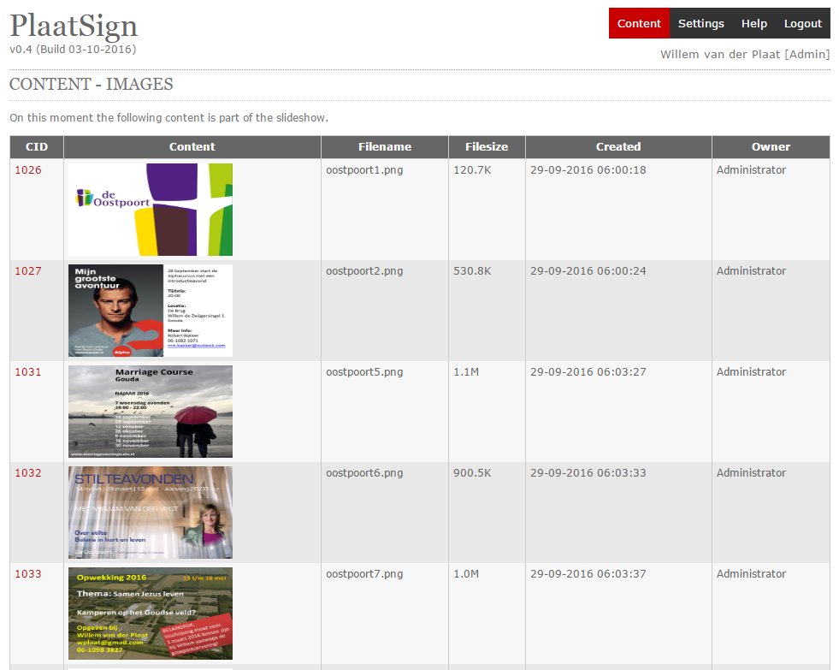

Slide 12
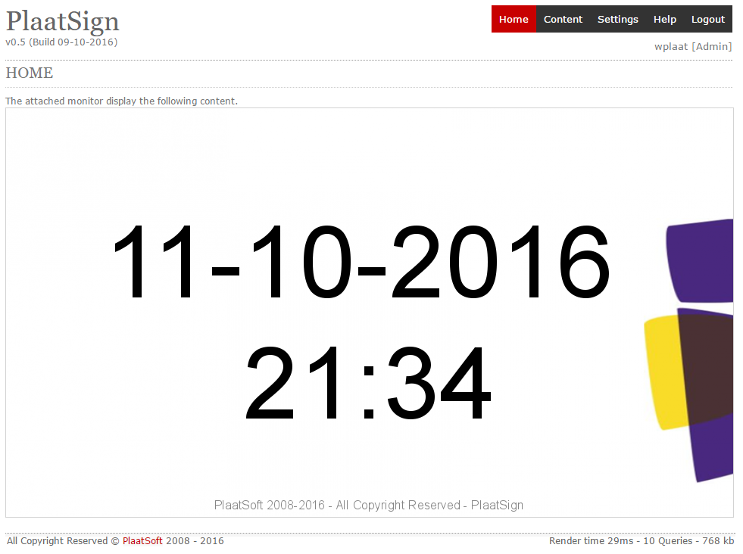

Slide 13
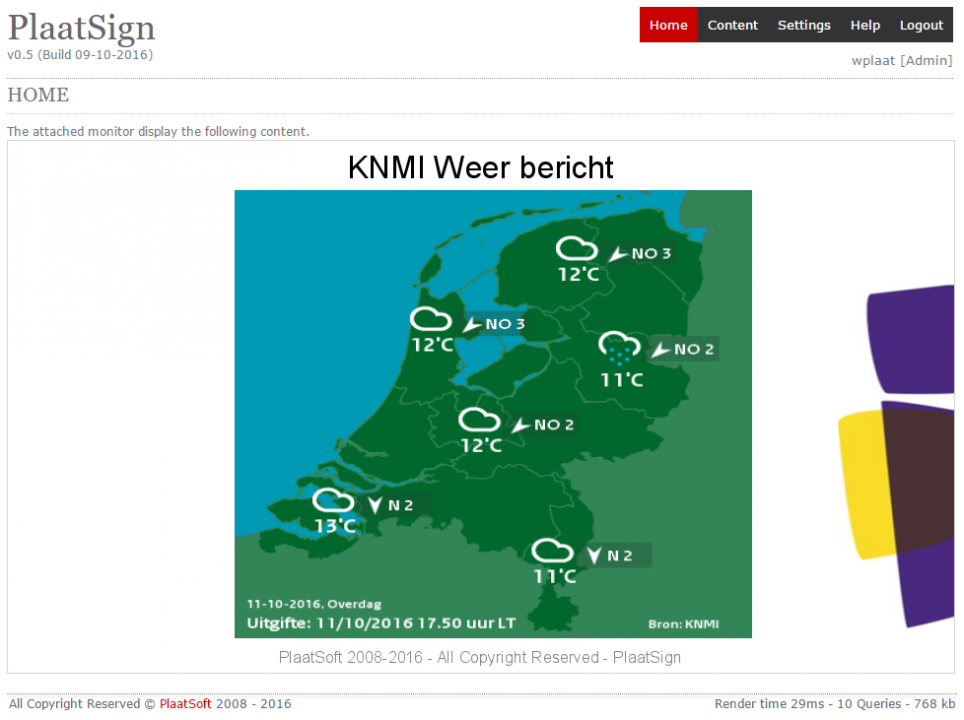

Slide 14
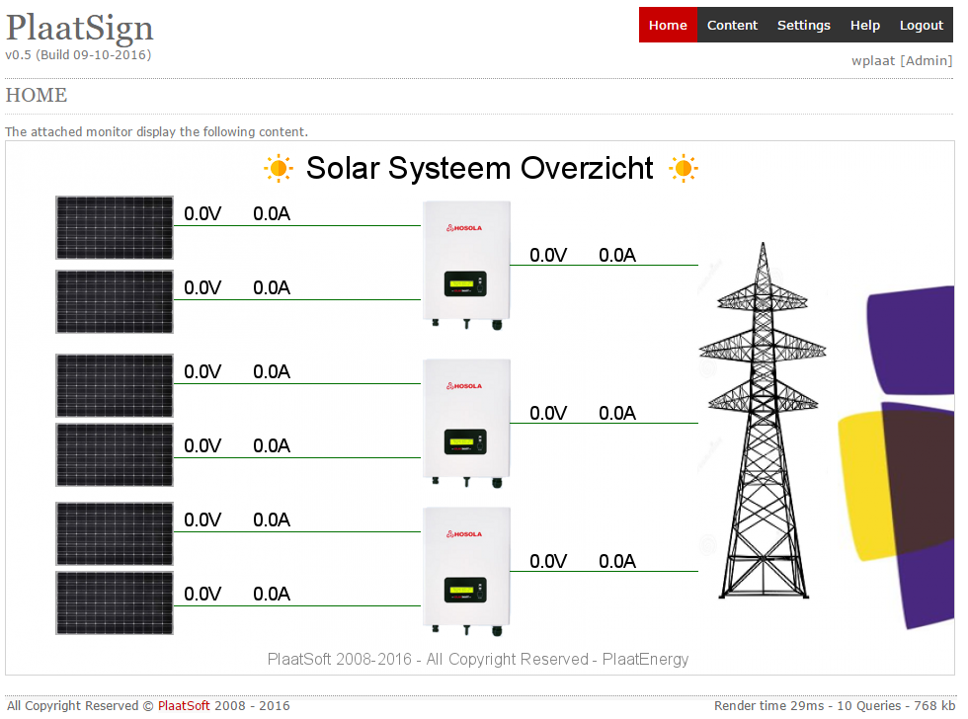

Slide 15
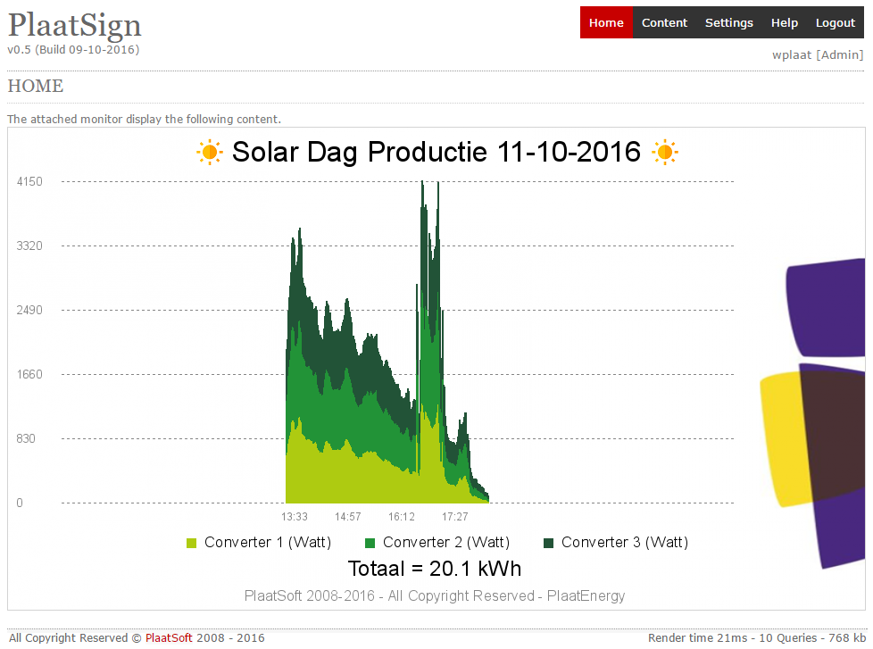

Slide 16
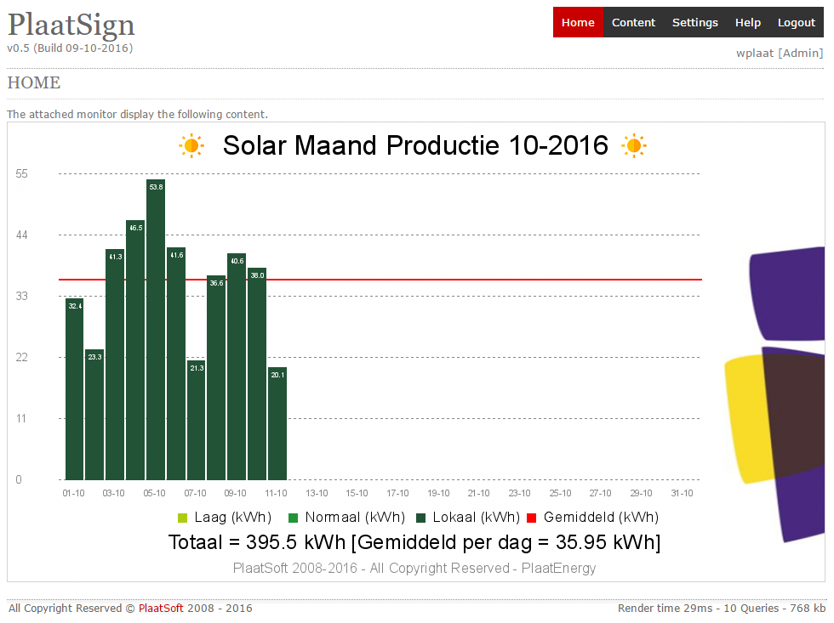

Slide 17
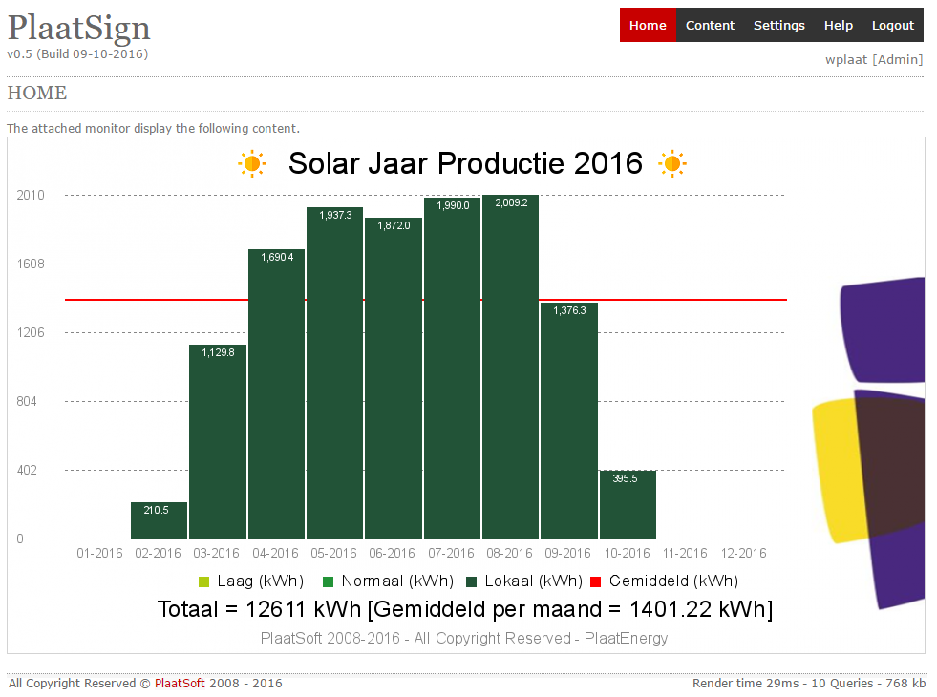

Slide 18
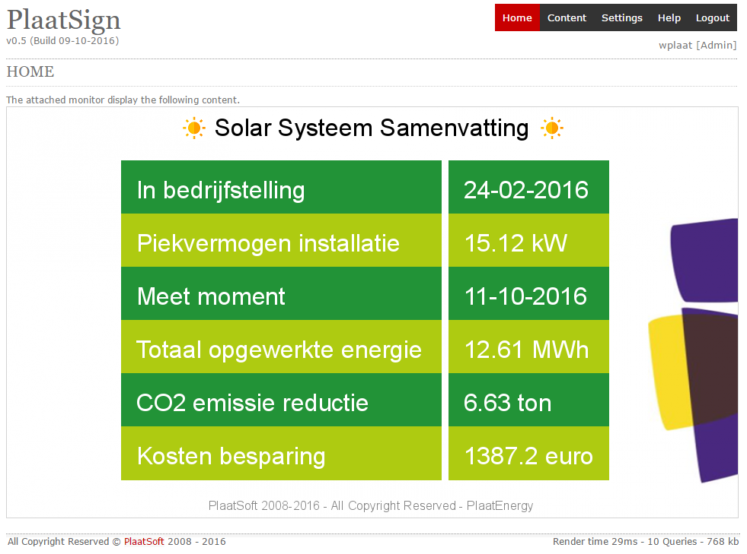

Slide 19
Conclusion
PlaatSign offers a free digital content viewer platform for the Raspberry Pi
Following content types are supported:
  Images
  Videos
  Scripts
New features will be added soon

Slide 20

IR
Detector
More info
visit
plaatsoft.nl

