Slide 1

PlaatProtect
(Burglar / Fire Alarm Centre)
Open Source Project
W.B.J. van der Plaat
(Principal IT Architect)

Slide 2

Questions
How can I protect my family and house against burglars?
How can I protect my family and house against fire?

Slide 3


Idea
Lets create an application which detect movement & fire in my house and activate the necessary counter measure(s).
Web Gui
Use low cost hardware
Use Z-Wave technology
Use Zigbee technology

Slide 4
PlaatProtect - Features
Burglar / Fire Alarm Centre on Raspberry Pi
  Integrate Webcams
    Motion detection with auto recording
  Integrate Z-Wave meshwork
    IR detector(s)
    Alarm Horn
  Integrate Zigbee meshwork
    Control lights
    Fire detector
  Notification
    Push Message to Mobile
    Email
  Scenario support
    Home, Sleep, Away

Slide 5
PlaatProtect Software Architecture
Google Charts
Mobile Push Service
Email Push Service
WS/JSON/JS
Presentation Layer
PHP/CSS/JS
Apache
Business Logic Layer
PHP
Database Layer
MySQL
REST
Interface
Zigbee
Interface
Z-Wave
Interface
Webcam
Interface
PHP
Operating
System
Debian Linux
Vendor Support
Philips HUE
Vendor support
Google Protect
Vendor support
- Aeotec
- Aeon
Vendor support
Sony
Logitec

Slide 6
Information Exchange
GUI
files
Directory
files
Webcam
Interface
Service
Bus
(Implemented in
Database)
json
Z-Wave
Interface
json
json
Zigbee
Interface
json
Email
Interface
Process Event Handler
json
json
Android Notification

Slide 7
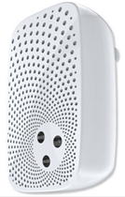
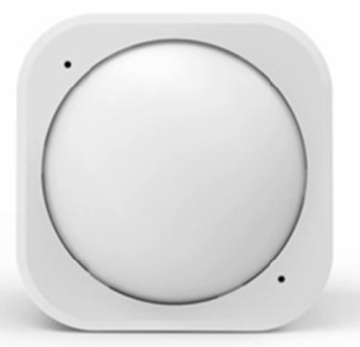
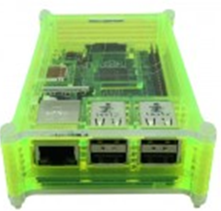
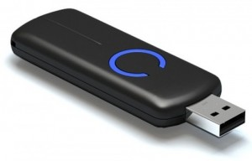
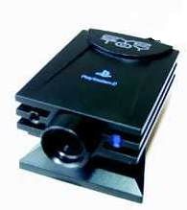

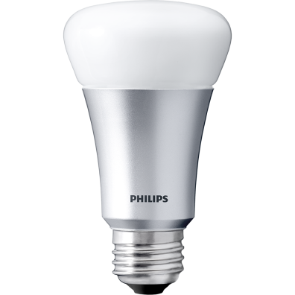
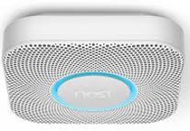
Used hardware
Raspberry Pi 3B
Philips Hue Light Bulb
Philips Hue Light Strip
Z-Wave USB Dongle
Z-Wave Aeon Horn
Z-Wave Aeotec IR detectors
Google Nest Protect
USB Webcam

Slide 8





Hardware View – Configuration 1
Light
Bulb
Light
Strip
Zigbee
(mesh network)
Raspberry Pi
PlaatProtect
Sense Hat (Pi)
Wifi
Wifi Router
Ethernet
USB
Z Wave
(mesh network)
Ethernet
ADSL Router
USB
USB
Ethernet
IR
Detector
Notification
Internet
Alarm
Horn
Webcam
1
Webcam
2
Fire
Detector

Slide 9
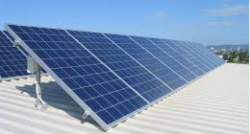
Hardware View – Configuration 2
P1 cable
Digital Energy
Meter
Light Bulb
Light
Strip
Bluetooth
USB
Digital Gas
Meter
Solar
Converter
Raspberry Pi
PlaatEnergy
PlaatProtect
Sense Hat (Pi)
Zigbee
(mesh network)
Wifi
Wifi
Ethernet
Z Wave
(mesh network)
Wifi Router
USB
Z Wave
(mesh network)
Ethernet
ADSL Router
USB
USB
Ethernet
IR
Detector
Notification
Internet
Alarm
Horn
Fire
Detector
Webcam
1
Webcam
2

Slide 10

Scenario – Home
IR
Detector
Light
Bulb
Movement
Alarm
Activate
Bulb
Event
Data
PlaatProtect
Cloud Storage

Slide 11
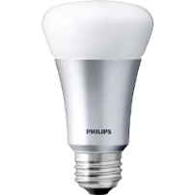
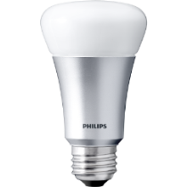
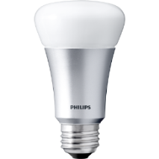
Scenario – Sleep
Webcam
Light Bulbs
Webcam
Movement
Detected
IR
Detector
Activate
some
Light Bulbs
IR
Detector
Movement
Or
Vibration
Alarm
Activate
Horn
Horn
IR
Detector
Event
Data
PlaatProtect
Video
Stream
IR
Detector
Cloud Storage

Slide 12

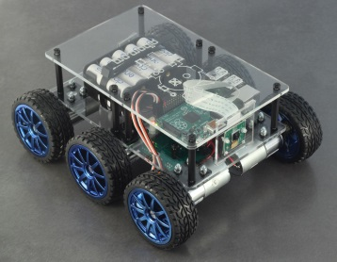
Scenario – Away
Bulb Lights
Webcam
Mobile
Webcam
Send
push message
to mobile(s)
Movement
Detected
Activate
all
Light Bulbs
Email
IR
Detector
Send
Email
IR
Detector
Movement
Or
Vibration
Alarm
Activate
Horn
Horn
IR
Detector
Activate Drone
“Search and …..”
Event
Data
TOP
SECRET
PlaatProtect
Video
Stream
IR
Detector
PiZorg
Cloud Storage

Slide 13
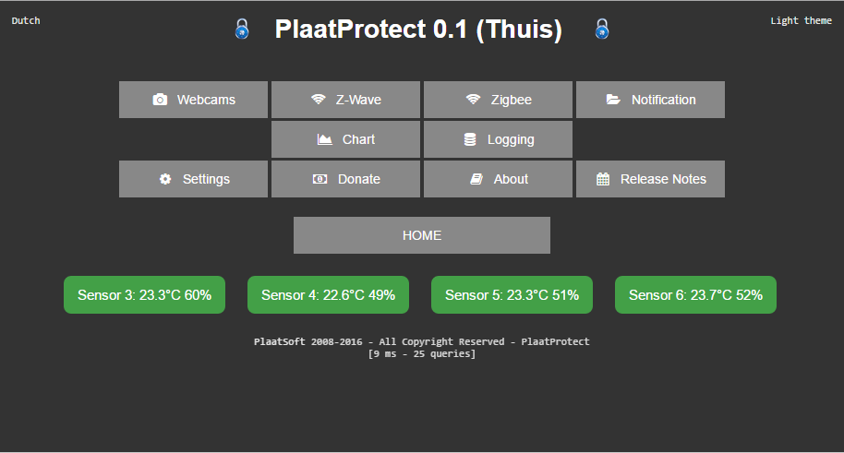

Slide 14
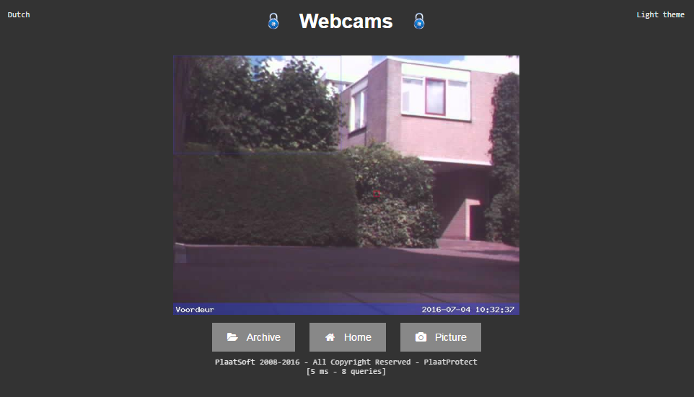

Slide 15
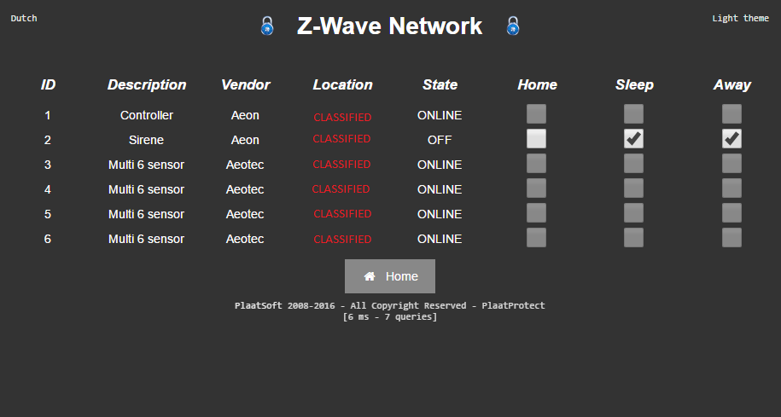

Slide 16
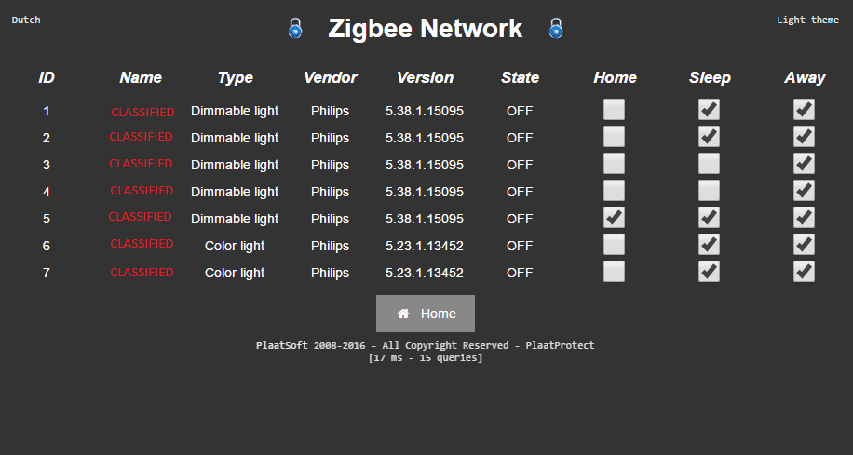

Slide 17
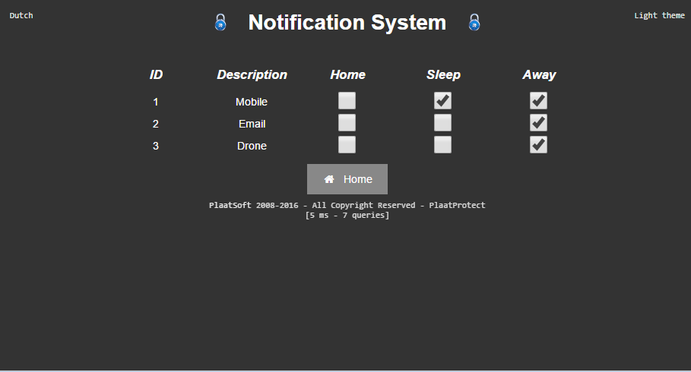

Slide 18
Conclusion
My family and house are “better” protected against burglars
One burglar attempt in my street captured on video and shared with Police ☺
Learned a lot about Z-Wave protocol. Z-Wave protocol specification is not public 😐
Google Nest Protect Zigbee integration not possible. Only web service integration possible ☹
Learned a lot about basic video motion detection

Slide 19

IR
Detector
More info
visit
plaatsoft.nl

